Slide 1

Economics Department
Centre for Computational Finance and Economic Agents
Kiel Institute for the World Economy:6th Kiel Institute Summer School on Economic Policy Policy,June 24 – 30, 2012
Professor Sheri Markose
Economics Department (University of Essex)
Multi-Agent Financial Network Models (MAFN) For Systemic Risk Management: A New Complexity Perspective
Lecture 1 Eigen-Pair Analysis of Financial Systemic Risk and Design of Super-Spreader Tax To Mitigate Moral Hazard
scher@essex.ac.uk
The software used in network modelling was developed by Sheri Markose with Simone Giansante and Ali Rais Shaghaghi

Slide 2
Lecture 1 :Roadmap
  New Office of Financial Research in the US Treasury to put an end to regulators flying blind
  Put an end to balkanization of data
  Two methodological problems on financial contagion and systemic risk : (i)Paradox of Volatility and the pitfalls of market price data based systemic risk measures hence structural bilateral data based networks modeling needed (ii) Negative Externalities problem the need for holistic visualization
  Two applications used: Systemic Risk From Global Financial Derivatives Modelled Using Network Analysis of Contagion and Its Mitigation With Super-Spreader Tax
  Indian Financial System and Bilateral Data based Modelling: Pioneering first full bilateral analysis

Slide 3
Lecture 1:Roadmap contd Applications to Systemic Risk from Global Derivatives , Indian Financial System
  Stability of Networks and Eigen-Pair Analysis: Markose et. al. (2012)
  3 main questions of macro-prudential regulation :
  (i)Is financial system more or less stable?
  (ii)Who contributes to Systemic Risk ?
  (iii)How to internalize costs of systemic risk of ‘super-spreaders’ using Pigou tax based on eigenvector centrality: Management of moral hazard
  Furfine Stress Test
  Superspreader Lite Escrow Fund
  Results
Conclusions

Slide 4
Overview Lecture 2:Three major methodological issues on why policy fails:Why no dogs barked? Robust Policy Design and monitoring needs to move away from macro-econometric models to MAFNs
Why was the need for macroprudential framework eschewed? Mainstream Neoclassical ‘Representative Agent’ Models; Unfortunate Irrelevance of Most State of the Art Monetary Economics (Buiter 09); evolutionary nature of money and credit
2.Why were there no system wide quantitative models developed for stress tests of how the financial network would function under these micro regulatory rules of individual bank behaviour?
Failure of macro-econometric models for policy analysis (Lucas Critique);we have yet to replace this with multi-agent fine grained data base driven financial network models
3. Urgent need for modelling tools to monitor liquidity gridlocks,direction of an ongoing financial contagion, systemic risk : Multi-Agent Financial Network Models ie. intelligence based models that can monitor perverse incentives
Answer: Lack of Complex Adaptive System framework- Red Queen type competitive co-evolution esp between regulator and regulatee requires constant vigilance and production of countervailing measures(Markose 2004, 2005) Robert Axelrod on Fragility of Communication Networks : Overlook Competitive Co-evolution

Slide 5
Methodological Challenges to Measuring Systemic Risk : Statistical v. Causal Models
DEFINITION: Economic and financial contagion refers to the spreading of a negative shock on the solvency conditions of an economic or financial entity in a physical supply chain or in terms of generic credit/debt and liquidity obligations governing interbank, payment and settlement systems and/or claims on other financial markets
Structural model based on default causality of chain reactions governed by the network connections of the financial entities
In contrast, models made popular by Kaminsky and Reinhart (2000) view financial contagion as the downward co-movement of asset prices across different markets and for different asset classes. This is based on statistical or econometric methods which measure (amongst other ways) the increased correlations of asset prices
Above models complimentary to the causal default models that use financial network simulations, especially in the use of contagion models based on CDS price co-movements (Jorge Chan-Lau et al., 2009)

Slide 6
(i)Paradox of Volatility or Paradox of Stability
Major drawback of market price based systemic risk measures is that they can suffer from the paradox of financial stability (Borio and Drehman (2009)) or the paradox of volatility, issues first addressed by Hyman Minsky (1982).
Market based statistical proxies for systemic financial fragility are at their lowest just before the point of great financial collapse and hence while there may be some information in the cross-sectional data of FI’s contributions to systemic risk, the aggregated systemic risk statistics are at best contemporaneous with the crisis in markets.
As credit growth boosts asset prices, CDS spreads and VIX indices which are inversely related to asset prices are at their lowest precisely before the crash when asset prices peak.

Slide 7
Examples of Statistical Measures of Systemic Risk
To analyze so called interconnectedness risk between FIs, matrix of bilateral correlations or non-linear copula based co-movements purported to represent extreme market conditions is constructed from market price data.
Market-based systemic risk measures that have been proposed: Conditional VaR (CoVaR) Adrian and Brunnermeier (2009); System Expected Shortfall (SES) Acharya et al. (2010); Co-risk by Chau-Lan (2010); DIP (Distress Insurance Premium) by Huang et al. (2010); POD (Probability that at least one bank becomes distressed) by Segoviano and Goodhart (2009), Shapley-Value by Tarashev et. al. (2010) and Macro-prudential capital by Gauthier et. al (2009).
To reverse the procyclical consequence of contemporaneous market prices in a market price based systemic risk measure, Adrian and Brunnermeir (2009) in the forward Co-VAR include panel data on lagged FI specific characteristics such as size, leverage, maturity mismatch etc. This supplemented quantile regressions for forward Co-Var produced was found to be inversely related to the systemic risk measure based on market price data alone.

Slide 8
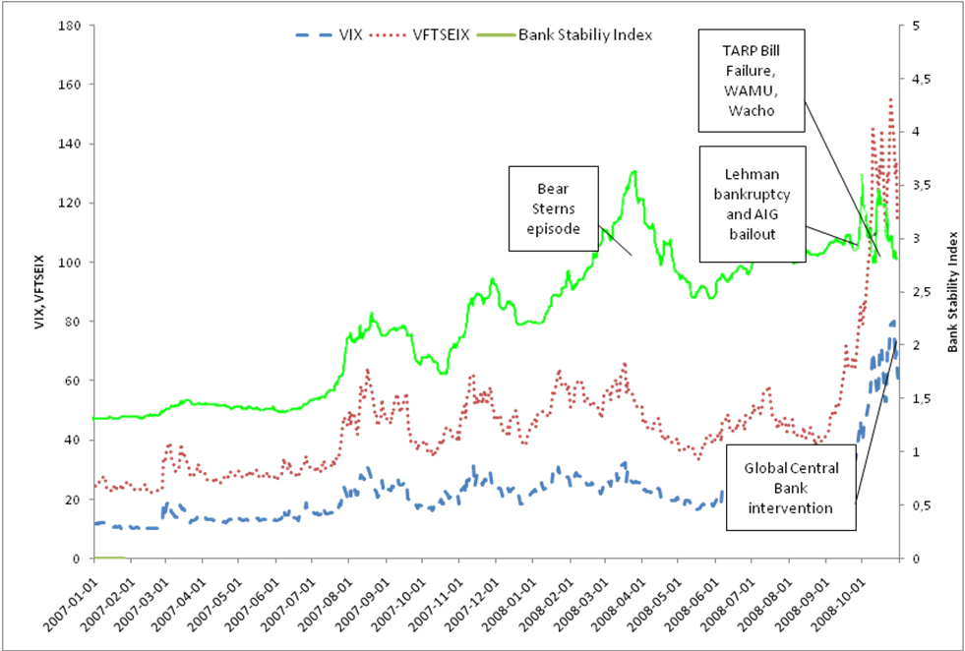
Banking Stability Index (Segoviano, Goodhart 09/04) v Market VIX and V-FTSE Indexes : Sadly market data based indices spike contemporaneously with crisis ; devoid of requisite info for Early Warning System

Slide 9
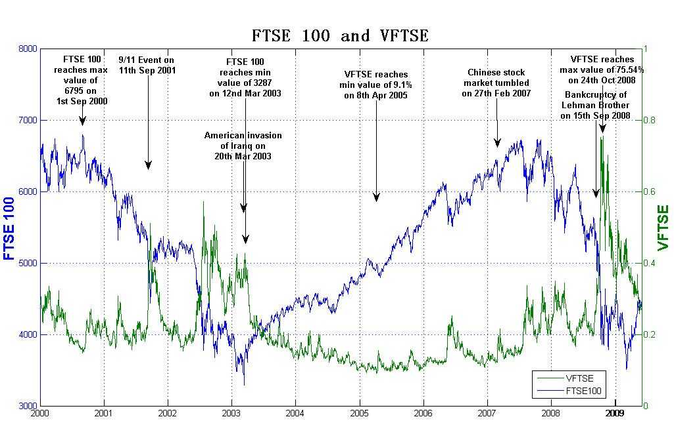
“Paradox of stability” : Stock Index and Volatility Index Paradox of Volatility (Borio and Drehman(2009); Minsky (1982))

Slide 10
(ii) Fallacy of Composition In the Generation of Systemic Risk/Negative Externalities: Holistic Visualization Needed
Systemic risk refers to the larger threats to the financial system as a whole that arise from domino effects of the failed entity on others.
At the level of the individual user these schemes appear plausible but at the macro-level may lead to systemically unsustainable outcomes.
Example 1 : Risk sharing in advanced economies uses O-T-C derivatives.
Success of risk sharing at a system level depends on who is providing insurance and structural interconnections involved in the provision of guarantees.
Only 5% of world OTC derivatives is for hedging purposes
Credit Risk Transfer in Basel 2 gave capital reductions from 8% to 1.6% capital charge if banks got CDS guarantees from ‘AAA’ providers . Most of this held in trading accounts
Example 2: Outsourcing of Pension Fund Management
Example 3: Indian banks’ exposure to foreign LCFIs

Slide 11
Digital Mapping of Financial Sector: For over two decades central bankers and monetary/financial academics have had no incentives to study the financial system in a quantitative integrated way (Gary Gorton

Slide 12
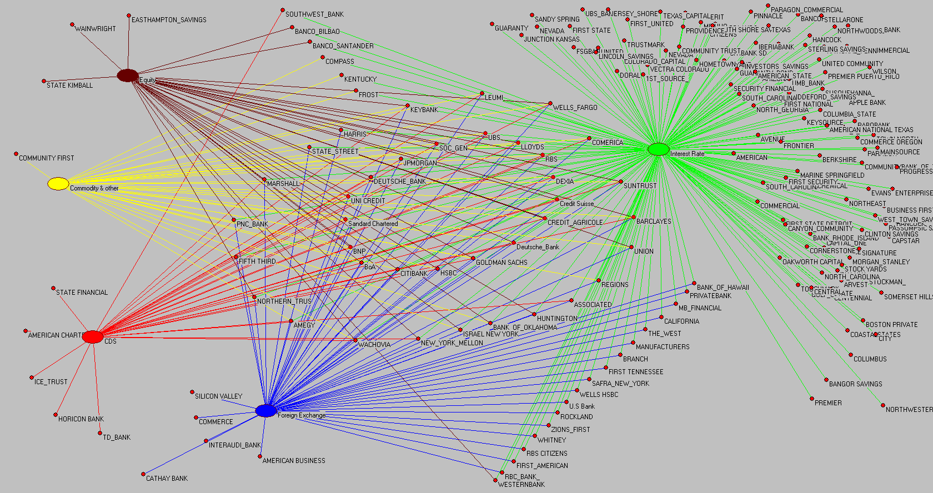
Structure of Global Financial Derivatives Market (2009,Q4 204 participants): Green(Interest Rate), Blue (Forex), Maroon ( Equity); Red (CDS); Yellow (Commodity); Circle Broker Dealers in all markets

Slide 13
Total Value and Market Share of Financial Derivatives for Banks Q4 2009
(1)The total value of financial derivatives is in billions of US dollars. (2) The market shares are in parenthesis. (3) Banks are ranked using Gross Notional
 | All FIs | Top 16 FIs | Top 26 FIs
Gross Notional | 674.369 | 659.263 (97.76%) | 673. 827 (99.92%)
Gross Positive Fair Value (GPFV) | 10.465 | 10.254 (97.98%) | 10.453 (99.89%)
Gross Negative Fair Value (GNFV) | 10.144 | 9.934 (97.92%) | 10.134 (99.89%)
Derivatives Assets | 1.168 | 1.068 (91.39%) | 1.15 (98.52%)
Derivatives Liabilities | 0.889 | 0.816 (91.78%) | 0.874 (98.33%)
Total Assets | 37.252 | 27.863 (74.80%) | 32.837 (88.15%)
Tier 1 capital | 1.413 | 1.014 (71.60%) | 1.207 (85.48%)

Slide 14
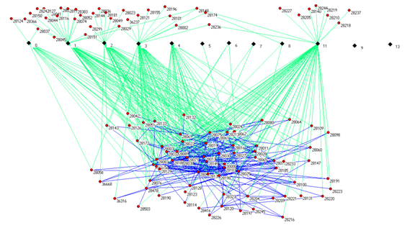
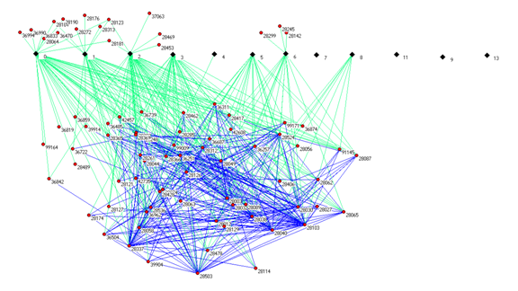
UK Fund Management 1984 and 2004 (Source Blake et. al 2010) Fund sponsors think they are diversifying by outsourcing to specialist fund managers: concentration and herding at system level

Slide 15
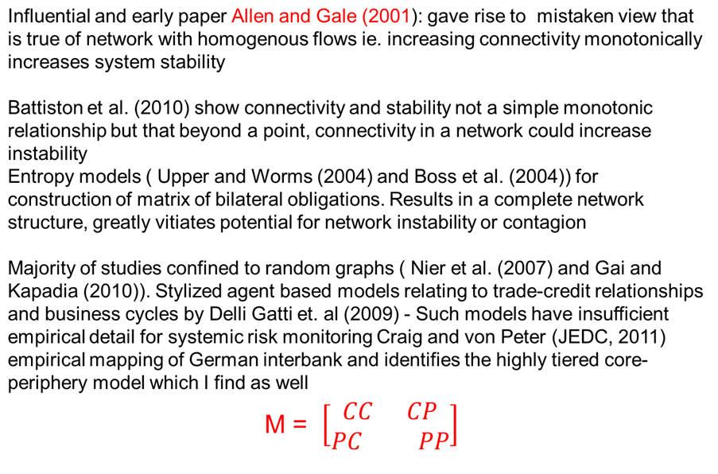
Financial network models to date have yielded mixed results : None about propagators of 2007 crisis C: Core; P Periphery (see Fricke and Lux (2012)

Slide 16
Properties of Networks
Diagonal Elements Characterize Small World Networks
Watts and Strogatz (1998), Watts (2002) See Markose et. al. (2004)

Slide 17
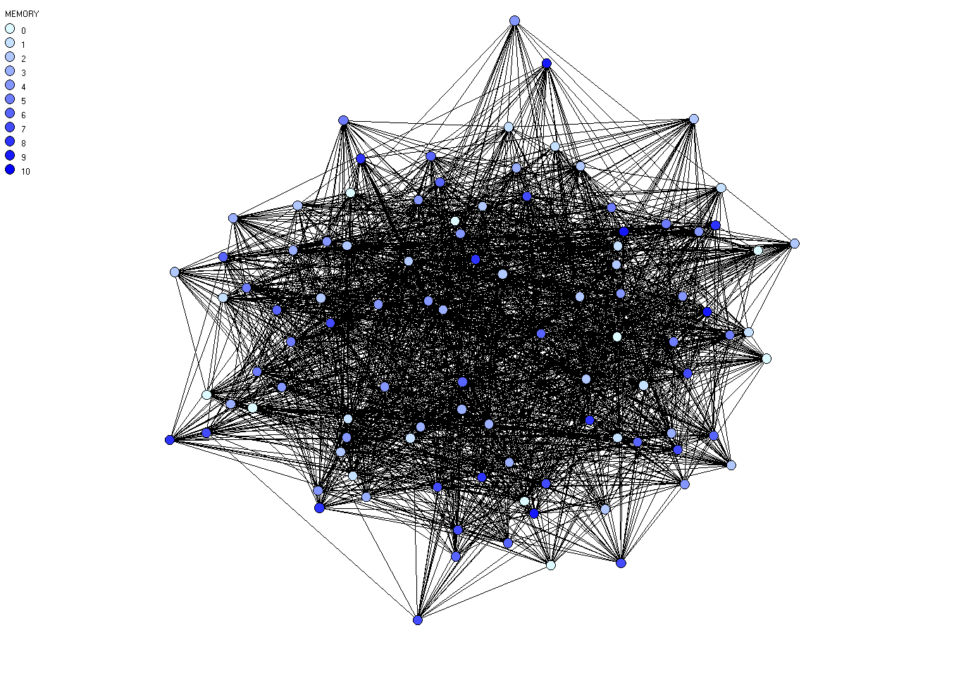
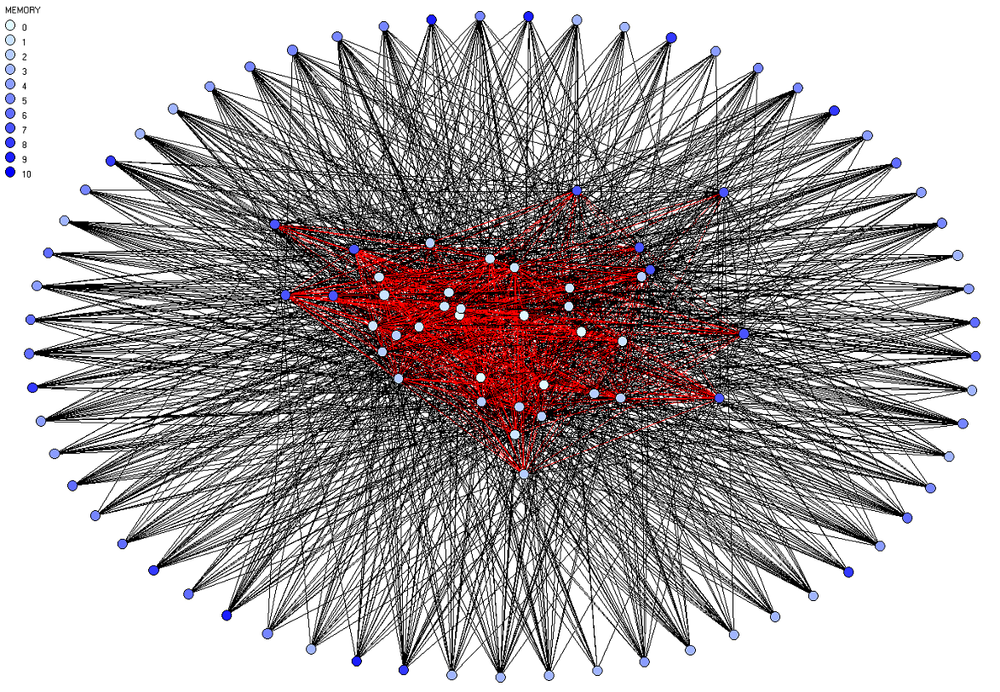
Some Networks: A graphical representation of random graph (left) and small world graph with hubs, Markose et. al. 2004

Slide 18
Sheri Markose and Simone Giansante RBI Project in mapping the Indian financial system shows the following networks structures
Top RHS Derivatives Exposures : Shows highly tiered core-periphery structure with large numbers of participants in the periphery and a few in the core
Characterization of Too Interconnected to Fail
Top LHS Interbank Exposures: Shows a more diffused core with more numbers of banks in the core
Bottom: network for Indian RTGS shows no marked tiering with few financial institutions in the periphery

Slide 19
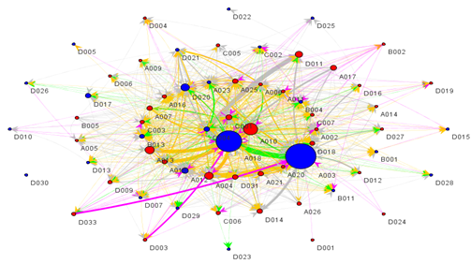
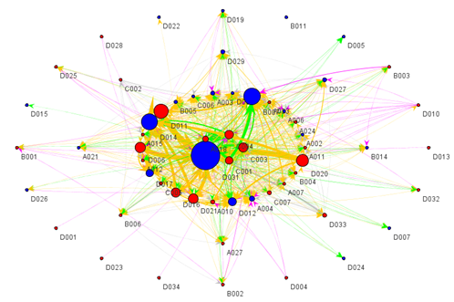
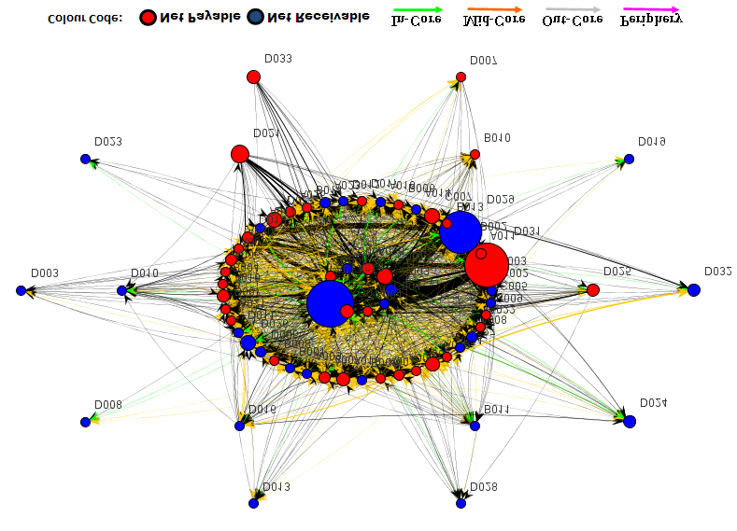
FUNDED
DERIVATIVES
RTGS

Slide 20
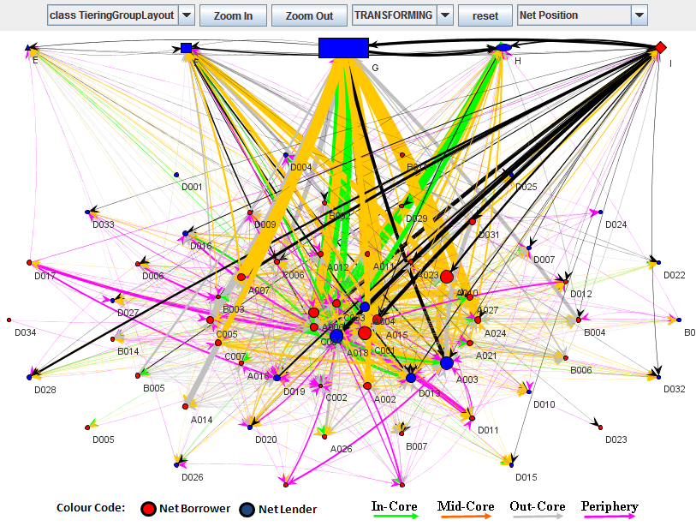
Bank-Bank Within A larger System with non bank FIs- Net Lenders to Banks Are Mutual Funds and Insurance Companies (Code G)

Slide 21
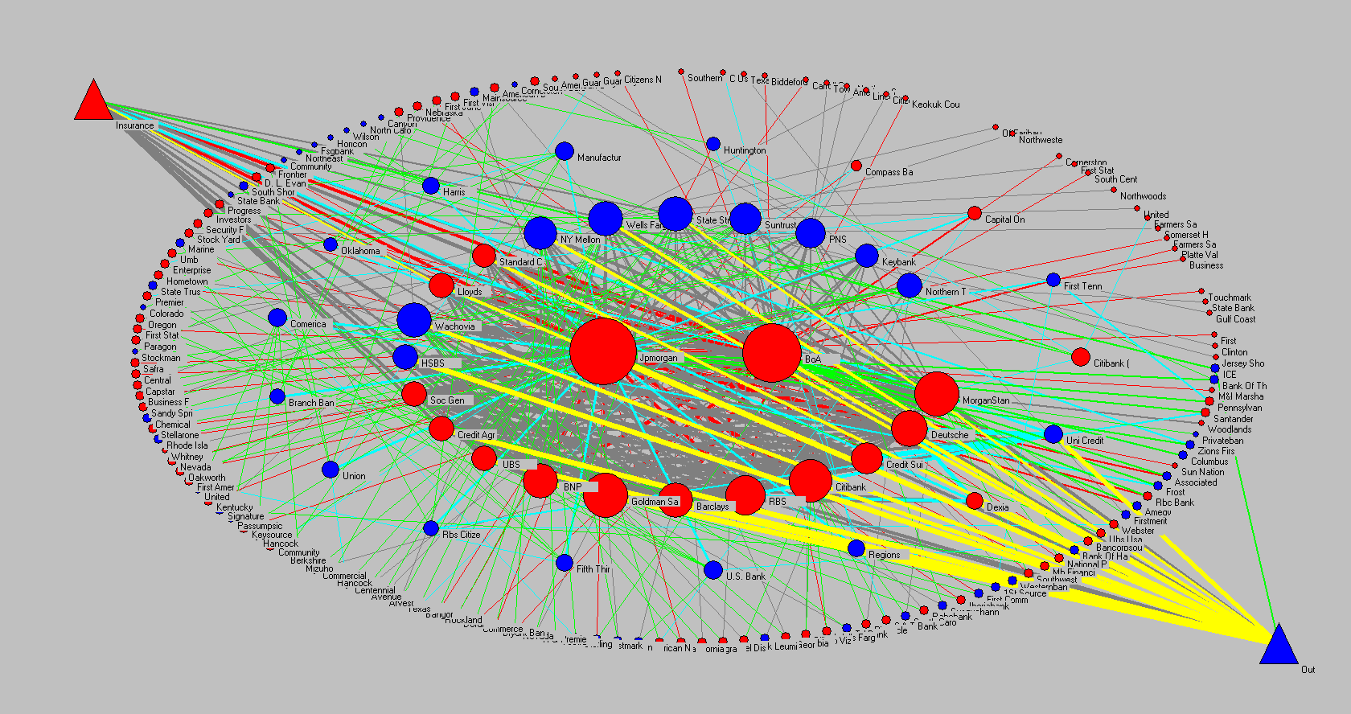
Global Derivatives Market (Θ matrix) : JP and BoA central Tier; 22 other banks in Tier 2 all banks in the top tiers will fail if any other fails of this group

Slide 22
Markose et. al. Eigen Pair Analysis
Monitoring Systemic Risk : Is the financial system becoming more or less stable ?
Monitor maximum Eigen-value of the ratio of net liabilities to Tier 1 capital matrix

Slide 23
Gross Exposures : Row Bank are Borrowers (Protection Sellers in Derivatives) ; Column Banks are Lenders (Protection Buyers in Derivatives)

Slide 24
Constructing the network of bilateral exposures
0 222.91 138.37 129.28 109.64 105.29 …
221.42 0 124.15 116.34 104.96 100.80 …
126.66 122.08 0 70.80 60.04 57.66 …
118.78 114.48 71.07 0 56.31 54.07 …
105.10 101.29 62.88 58.74 0 47.84 …
95.87 92.40 57.36 53.58 45.44 0 …
… … … … … … …
X =
M = X – X^{T} : antisymmetric matrix of derivatives payables
m_{ij} > 0 is net payables by node i from node j
m_{ji} = – m_{ij} is corresponding amount by j to i
Considering only matrix of +ve values, i.e., m+_{ij} = m_{ij} if m_{ij} >0, m_{ij}= 0 otherwise
we obtain the weighted adjacency matrix for the directed network
0 1.49 11.71 10.49 4.54 9.42 …
0 0 2.08 1.86 3.67 8.40 …
0 0 0 0 0 0.30 …
0 0 0.27 0 0 0.49 …
0 0 2.84 2.44 0 2.40 …
0 0 0 0 0 0 …
… … … … … … …
links point from the net borrower or net protection seller in derivatives to the net buyer (the direction of contagion)
M+ =

Slide 25
Contagion and Stability of Matrix Θ’ : Impact of i on j relative to j’s capital

Slide 26
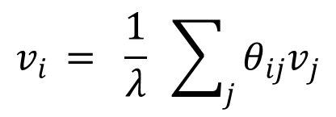
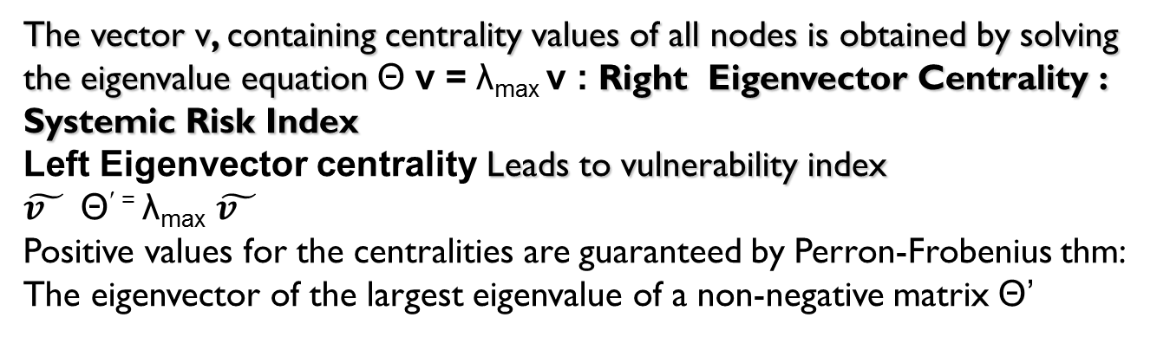
Eigenvector Centrality
A variant is used in the Page Ranking algorithm used by Google
Centrality: a measure of the relative importance of a node within a network
Eigenvector centrality
Based on the idea that the centrality v_{i} of a node should be proportional to the sum of the centralities of the neighbors
λ is maximum eigenvalue of Θ
The vector v, containing centrality values of all nodes is obtained by solving the eigenvalue equation Θ v = λ_{max} v : Right Eigenvector Centrality : Systemic Risk Index
Left Eigenvector centrality Leads to vulnerability index
$\tilde{v_{}}$ Θ^{′ =} λ_{max} $\tilde{v_{}}$
Positive values for the centralities are guaranteed by Perron-Frobenius thm: The eigenvector of the largest eigenvalue of a non-negative matrix Θ’

Slide 27
Stability of the dynamical network system : Eigen Pair (λ_{max}, v)
λ_{max} is maximum eigenvalue of Θ
Dynamics of bank failures given
U_{t +1} = [Θ´ + (1- ρ)I] U_{t} = S U_{t} (10)
I is identity matrix and ρ is the % buffer
U₀ with elements (u_{1t} , u_{2t}, ..... u_{nt}) = (1,0,......0) to indicate the trigger bank that fails at initial date, t=0, is bank 1 and the non-failed banks assume 0’s

Slide 28
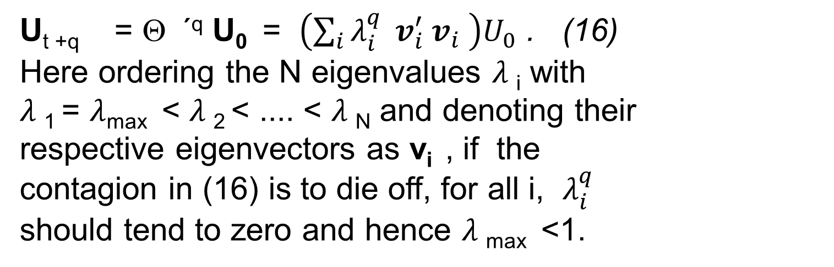
Stability Condition λ_{max}(Θ´) < ρ
After q iterations

Slide 29
Too Interconnected To Fail :
Stress Test
Objective: Build CDS Network and Conduct Stress Tests
There is very high correlation between the dominance of market share in CDS and CDS network connectivity
Stress Tests: Follow Furfine (2003) Algorithm
The loss of derivatives cover/receivables due to the failed bank as counterparty suspending its guarantees will have a contagion like first and multiple order effects. Full bilateral tear up assumed; No possibility for Novation
There is a power iteration M^{q} where q is the qth power of the netted matrix. At each q, weighted paths of length q between each i and j nodes is obtained
We use 6% reduction of core capital to signal bank failure

Slide 30
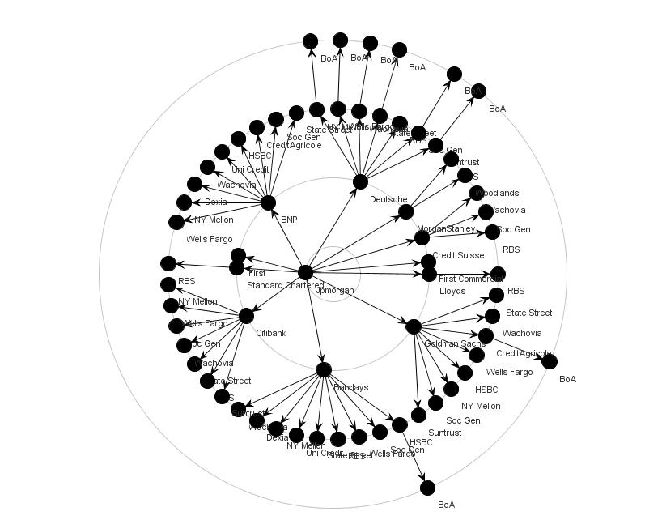
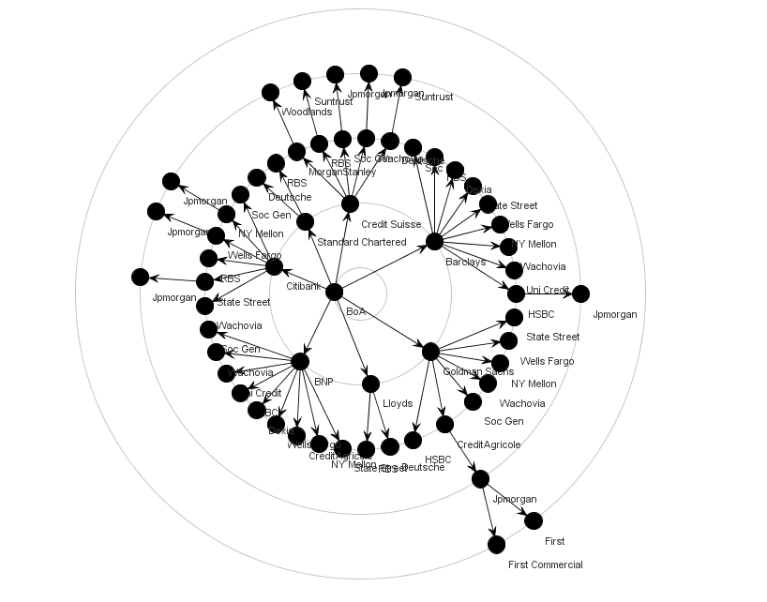
Contagion from JP Morgan (LHS; 12 direct counterparties) BoA (RHS; 7 direct counterparties )

Slide 31
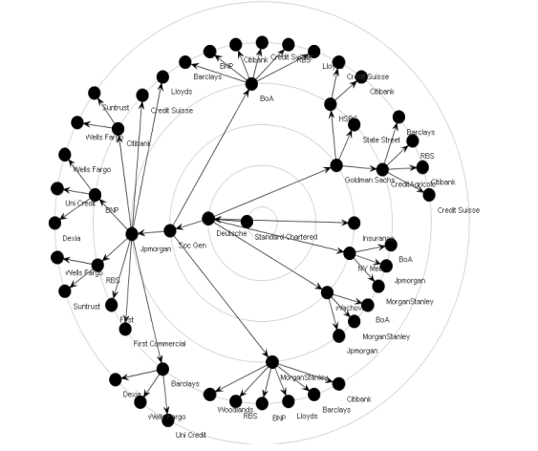
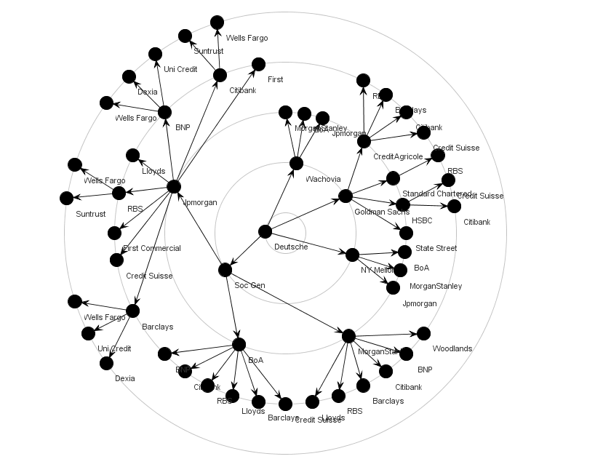
Contagion from
Deutsche Bank (LHS; 4 direct c-parties demised) Standard Charter (RHS; 1 direct c-parties)

Slide 32
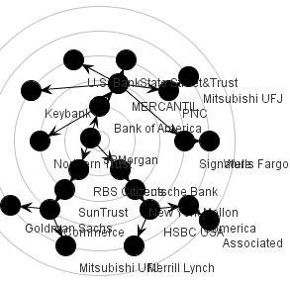
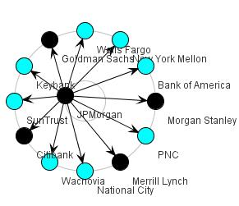
Contagion when JP Morgan Demises in Clustered CDS Network 2008 Q4 ( Left 4 banks fail in first step and crisis contained) v
In Random Graph (Right 22 banks fail !! Over many steps)
Innoculate some key players v Innoculate all ( Data Q4 08)

Slide 33
Mitigation of Systemic Risk Impact of Network Central Banks: How to stabilize ?
To date the problem of how to have banks internalize their systemic risk costs to others (and tax payer) from failure has not been adequately solved
In particular penalty for being too interconnected has not been dealt with from direct bilateral network data

Slide 34
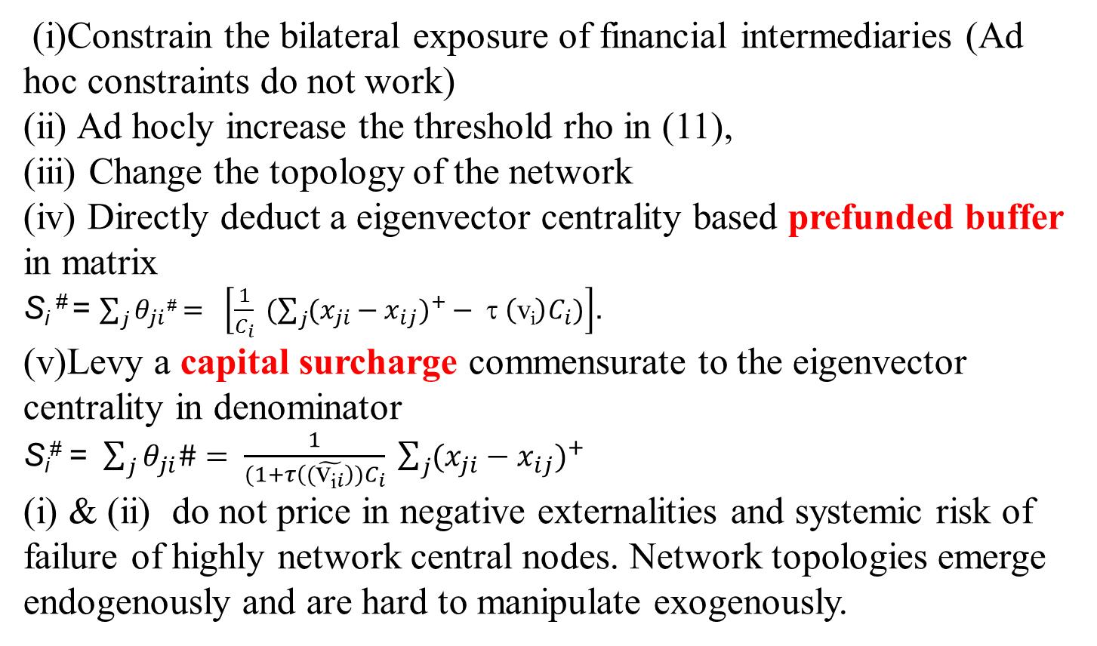
There are 5 ways in which stability of the financial network can be achieved
(i)Constrain the bilateral exposure of financial intermediaries (Ad hoc constraints do not work)
(ii) Ad hocly increase the threshold rho in (11),
(iii) Change the topology of the network
(iv) Directly deduct a eigenvector centrality based prefunded buffer in matrix
S_{i} # = $\sum_{j}{θ_{ji}\text{\#}}= \left[\frac{1}{C_{i}} (\sum_{j}{(x_{ji}}−x_{ij})^{+}− τ \left(\text{v}\text{i}\right)C_{i})\right]$.
(v)Levy a capital surcharge commensurate to the eigenvector centrality in denominator
S_{i}# = $\sum_{j}{θ_{ji}\#}= \frac{1}{{(1+τ\left((\tilde{{\text{v}\text{i}}_{i}}\right))C}_{i}} \sum_{j}{(x_{ji}}−x_{ij})^{+}$
(i) & (ii) do not price in negative externalities and systemic risk of failure of highly network central nodes. Network topologies emerge endogenously and are hard to manipulate exogenously.

Slide 35
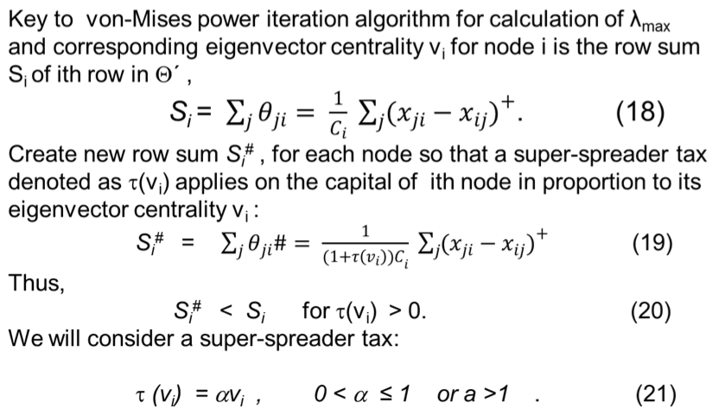
.Design of Pigou Tax To Internalize Systemic Risk Costs: Proportional to Damage

Slide 36
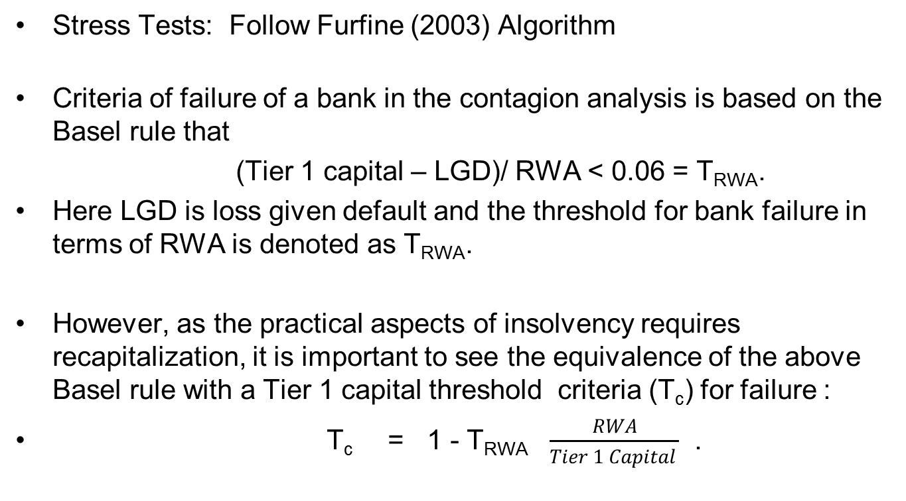
Too Interconnected To Fail :
Stress Test RBI Case, Contagion Analysis
Stress Tests: Follow Furfine (2003) Algorithm
Criteria of failure of a bank in the contagion analysis is based on the Basel rule that
(Tier 1 capital – LGD)/ RWA < 0.06 = T_{RWA}.
Here LGD is loss given default and the threshold for bank failure in terms of RWA is denoted as T_{RWA}.
However, as the practical aspects of insolvency requires recapitalization, it is important to see the equivalence of the above Basel rule with a Tier 1 capital threshold criteria (T_{c}) for failure :
T_{c} = 1 - T_{RWA} $\frac{RWA}{Tier 1 Capital }$ .

Slide 37
Socialization of Losses: Global Derivatives
Sergoviano and Singh (IMF 2008) Based on March 2008 data, in the case of a single institution failure, the total loss could be as high as $300–$400 billion depending on the FI; but when cascade effects are taken into account, the total loss could rise to over $1,500 billion.
Our 2009 Q4 results show direct domino losses
$ 350.6bn constituting 25% loss of Tier 1 capital of banks ; this does not include non-banks or non-US/European banks; that closet to $750 bn

Slide 39
Network Statistics –Scaling exponent (alpha) for outdegrees and for flows/exposures : those with higher connectivity have even higher liabilities (V1 204 nodes; V2 202 nodes)
Connectivity Clustering | Tail Exponent | Xmin | Max-Likelyhood
Outdegree (V1) 0.018 0.48 | 2.1 | 1 | -225.806
Flows (V1) | 2.49 | 7.95 | -167.081
Outdegree(V2) 0.013 0.45 | 2.15 | 1 | -209.727
Flows (V2) | 3.38 | 7.95 | -97.2634

Slide 40
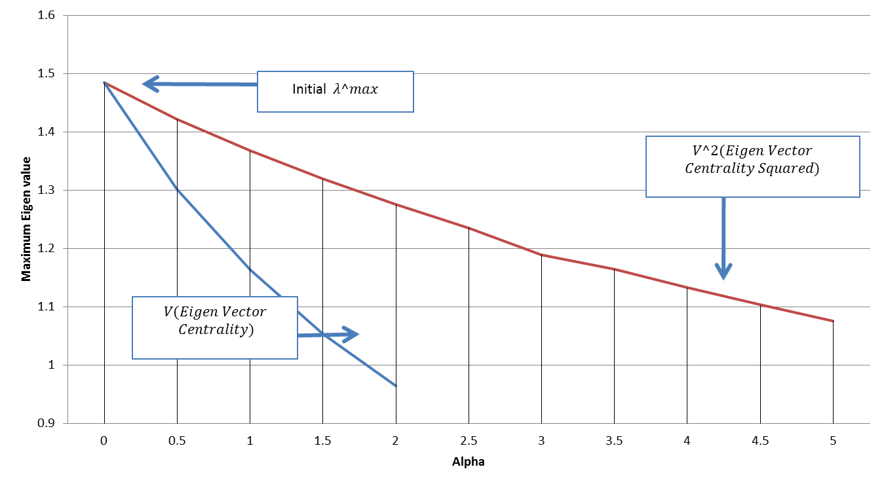
How to stabilize: Superspreader tax quantified : tax using Evcentrality of each bank Vi or vi^2 to reduce max eigenvalue of matrix

Slide 41
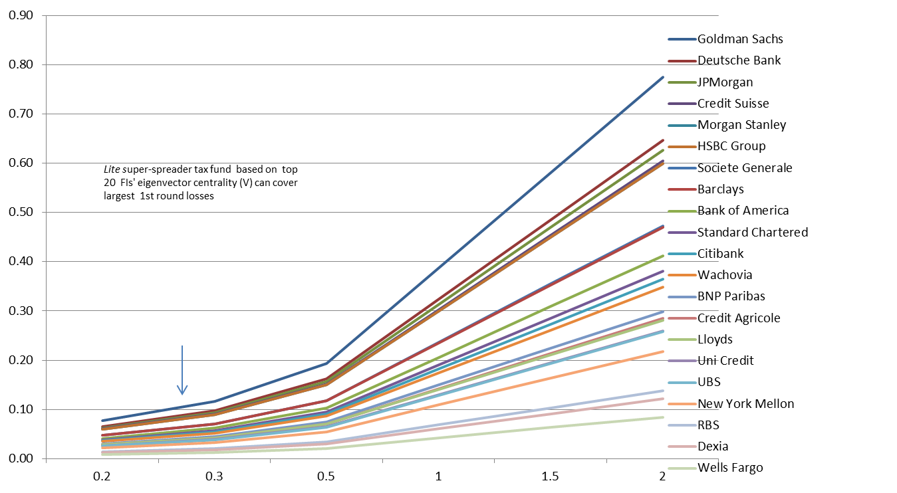
Superspreader tax rate

Slide 42
Table 7 Super-Spreader Tax Raised From Top 20 LCFIs (All columns other than EVC $bns) PTO
Note EVC is Eigenvector Centrality ; Tax % = EVC x alpha; Tax$s= Tax Rate x Tier 1 Capital
Super-spreader fund works like an escrow account; amounts escrowed as in a CCP or by regulator to be disbursed when default occurs
Super Spreader Fund lite : Secure funds to cover max losses of 1st tier (q=1) from any trigger bank failure
Full stabilization for λ_{max} < 1, costly implies tax rates of 77% of Tier 1 capital of Goldman Sachs etc

Slide 43
Conclusion :Systems are unstable and super-spreader taxes aim to mitigate instability
Too interconnected to fail addressed only if systemic risk from individual banks can be rectified with a price or tax reflecting the negative externalities of their connectivity
Lessons to be learnt : Disease Transmission in scale free networks (May and Lloyd (1998), Barthelemy et. al : With higher probabilities that a node is connected to highly connected nodes means disease spread follows a hierarchical order.
Highly connected nodes become infected first and epidemic dying out fast and often contained in first two tiers
Cold comfort for financial networks as failure of superspreaders destroys bulk of Tier 1 capital and history as we know it is over !
Innoculate a few rather than whole population; Strengthen hub; Reduce variance of node strength in dominant eigenvalue formula
Changes in eigenvector centrality of FIs can give early warning of instability causing banks

Slide 44
Ongoing tests and Concluding Remarks
Derivatives do not complete markets; excessive use causes tail risk; extant size a threat
Super spreader tax and fund recommended over ad hoc breakup of banks
Can eigenvector centrality based on adjacency matrix ie. unweighted eigenvector centrality be a sufficient proxy ?; less information is needed
Capital for CCPs to secure system stability can use same calculations
Further stress tests for robustness of ICE to see if .0013% capital is sufficient

Slide 45
Other Issues :Do Real World Financial Networks Satisfy Nash Equilibrium ?
Babus (2009) states that in “an equilibrium network the degree of systemic risk, defined as the probability that a contagion occurs conditional on one bank failing, is significantly reduced”. The premise of too interconnected to fail is that the failure of a big bank will increase the failure of another big bank, which we find to be the empirical characteristic of the network topology of the derivatives market involving US banks, indicates that the drivers of network formation in the real world are different from those assumed in economic equilibrium models.

Slide 46
Results of Systemic Risk Monitoring
Q1- Q4 2011 for Indian Banking Sector

Slide 47
Table 1: Total Borrowing and Lending for 76 Indian Banks (Q1,Q2, Q3, Q4 2011; Rs crores) Codes A (PSB); B(Old Pvt);C(New Pvt); D(Foreign)
 | MAR |  | JUNE
 | TOTAL BORROWING | TOTAL LENDING | TOTAL BORROWING | TOTAL LENDING
PSB | 322,360 | 352,412 | 287,780 | 344,946
OLD PVT | 25,819 | 35,372 | 22,934 | 34,578
NEW PVT | 113,258 | 78,591 | 126,621 | 69,744
FOREIGN | 169,933 | 164,996 | 156,646 | 144,714
TOTAL | 631,370 | 631,370 | 593,981 | 593,981
 | SEP |  | DEC
 | TOTAL BORROWING | TOTAL LENDING | TOTAL BORROWING | TOTAL LENDING
PSB | 337721 | 371072 | 353002 | 393493
OLD PVT | 27276 | 47720 | 24698 | 40449
NEW PVT | 154027 | 82272 | 143336 | 98394
FOREIGN | 147336 | 165298 | 184005 | 172705
TOTAL | 666361 | 666361 | 705040 | 705040

Slide 48
RBI Funded Sector (Q1-Q4 2011) Top 25 Banks Systemic Importance Measures : Net Liabilities , Eigen vector Centrality, Tiering

Slide 49
Table 2 RBI Annual Growth (%) in 2011 by 76 Banks Classified by Bank Type in the Funded and Non-Funded Sectors
Percentage change over the one year period (March 2011 to December 2011)
 | Public Sector Banks | Old Private Banks | New Private Banks | Foreign Banks | Banking Sector
Fund Based Borrowings | 17.8 | 22.5 | 51.9 | -18.1 | 19.9
Non Fund Based Borrowings | -12.5 | -37.1 | -3.4 | 16.2 | 1.4
Total Borrowings | 9.5 | -4.3 | 26.6 | 8.3 | 11.7
Fund Based Lending | 32.5 | -11.3 | -7.1 | 3.1 | 19.9
Non Fund Based Lending | -24.0 | 33.2 | 64.8 | 5.8 | 1.4
Total Lending | 11.7 | 14.4 | 25.2 | 4.7 | 11.7

Slide 50
Table 3 RBI: Total Tier 1 Capital and Risk Weighted Assets for 76 Indian Banks (Q1,Q2, Q3, Q4 2011; Rs crores)

Slide 51
Systemic Risk from Multi-Sector: Funded and Unfunded
Track Max Eigen-Value To see If Network System is More or Less Unstable ; Some Seasonality Q4 reduction in Instability
Total non sector netting leads to high Instability
Banks | FUND |  |  |  | NON - FUND |  |  |  | DERIVATIVES |  |  |  | TOTAL Netted |  |  |  | TOTAL No Cross sector netting
 | Q1 | Q2 | Q3 | Q4 | Q1 | Q2 | Q3 | Q4 | Q1 | Q2 | Q3 | Q4 | Q1 | Q2 | Q3 | Q4 | Q1 | Q2 | Q3 | Q4
Nodes | 76 | 76 | 76 | 76 | 76 | 76 | 76 | 76 | 76 | 76 | 76 | 76 | 76 | 76 | 76 | 76 | 76 | 76 | 76 | 76
Edges | 1279 | 1258 | 1274 | 1269 | 1152 | 1125 | 1159 | 1076 | 995 | 981 | 961 | 908 | 1605 | 1595 | 1624 | 1573 | 1948 | 1925 | 1978 | 1915
Connect | 0.22 | 0.22 | 0.22 | 0.22 | 0.20 | 0.20 | 0.20 | 0.19 | 0.17 | 0.17 | 0.17 | 0.16 | 0.28 | 0.28 | 0.28 | 0.28 | 0.34 | 0.34 | 0.35 | 0.34
CC | 0.38 | 0.40 | 0.39 | 0.41 | 0.40 | 0.39 | 0.40 | 0.40 | 0.41 | 0.39 | 0.40 | 0.40 | 0.41 | 0.41 | 0.42 | 0.42 | 0.52 | 0.51 | 0.53 | 0.54
EigenValue | 0.32 | 0.36 | 0.24 | 0.38 | 0.26 | 0.23 | 0.23 | 0.27 | 0.18 | 0.18 | 0.20 | 0.20 | 0.66 | 0.61 | 0.57 | 0.64 | 0.92 | 0.87 | 0.82 | 0.91

Slide 52
Is Basel II criteria far too lenient as solvency threshold ?
For the Indian banks for Q4 2011, for example, the Basel criteria implies that the median T_{c} is around 40%
On average percentage Tier 1 capital they can lose before declared a failed bank is 46%.

Slide 53
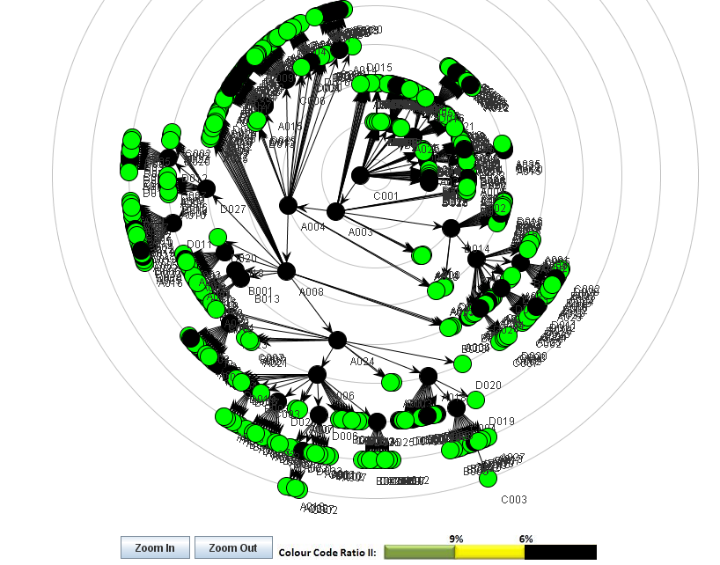
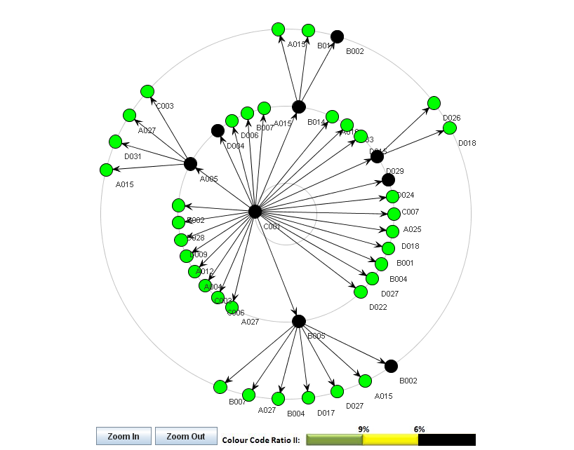
Contagion from Most EVC/ SI Bank : C001 Q4 2011(LHS before Stabilization;
RHS after Stabilization)

Slide 54
Contagion Losses from top 20 Systemically Important (Eigen-vector centrality) Banks :Total
Banks | EVC(r) | %C loss = %RWA | Contagion 6%RWA Contagion 25% Capital |  |  |  |  |  | 30% Capital
 |  |  | Global |  | n. DB | Global |  | n. DB | Global |  | n. DB
 |  |  | Loss (Rs cr) |  |  | Loss(Rs cr) |  |  | Loss(Rscr)
C001 | 0.35 | 0.27 | 195116.8 | 39.6% | 24 | 287288.2 | 58.3% | 41 | 283061.5 | 57.5% | 38
C004 | 0.34 | 0.54 | 103433.1 | 21.0% | 12 | 120968.2 | 24.6% | 20 | 119979.2 | 24.4% | 16
A018 | 0.31 | 0.25 | 80107.17 | 16.3% | 7 | 248875.9 | 50.5% | 39 | 110902 | 22.5% | 14
D031 | 0.30 | 0.26 | 42956.94 | 8.7% | 4 | 270333.1 | 54.9% | 42 | 86857.98 | 17.6% | 12
C003 | 0.28 | 0.46 | 33293.35 | 6.8% | 3 | 118993.8 | 24.2% | 20 | 113411.6 | 23.0% | 18
A010 | 0.26 | 0.30 | 33293.35 | 6.8% | 3 | 275405.3 | 55.9% | 42 | 88469.26 | 18.0% | 10
D011 | 0.22 | 0.52 | 25595.52 | 5.2% | 1 | 137228.5 | 27.9% | 21 | 83732.85 | 17.0% | 10
A015 | 0.20 | 0.25 | 24860.58 | 5.1% | 2 | 18176.84 | 3.7% | 3 | 18176.84 | 3.7% | 3
D020 | 0.18 | 0.58 | 21665.42 | 4.4% | 1 | 248875.9 | 50.5% | 39 | 79802.75 | 16.2% | 10
A001 | 0.16 | 0.20 | 15762.16 | 3.2% | 0 | 15762.16 | 3.2% | 0 | 15762.16 | 3.2% | 0
A004 | 0.16 | 0.36 | 21924.74 | 4.5% | 1 | 90302.43 | 18.3% | 14 | 12589.6 | 2.6% | 0
A006 | 0.15 | 0.15 | 10396.85 | 2.1% | 0 | 12837.97 | 2.6% | 2 | 12837.97 | 2.6% | 2
A013 | 0.15 | 0.10 | 11459.66 | 2.3% | 0 | 11459.66 | 2.3% | 0 | 11459.66 | 2.3% | 0
A008 | 0.15 | 0.23 | 11835.92 | 2.4% | 0 | 11835.92 | 2.4% | 0 | 11835.92 | 2.4% | 0
D014 | 0.12 | 0.60 | 28356.22 | 5.8% | 2 | 67498.46 | 13.7% | 10 | 19021.08 | 3.9% | 1
C007 | 0.12 | 0.35 | 11868.24 | 2.4% | 0 | 12706.82 | 2.6% | 3 | 12053.01 | 2.5% | 2
D017 | 0.12 | 0.21 | 8049.73 | 1.6% | 0 | 23597.42 | 4.8% | 2 | 14262.28 | 2.9% | 1
D006 | 0.11 | 0.57 | 16026.55 | 3.3% | 1 | 74189.87 | 15.1% | 11 | 16026.55 | 3.3% | 1
A025 | 0.10 | 0.25 | 9953.73 | 2.0% | 0 | 12394.85 | 2.5% | 2 | 12394.85 | 2.5% | 2
A023 | 0.10 | 0.28 | 17392.21 | 3.5% | 1 | 17601.8 | 3.6% | 2 | 17601.8 | 3.6% | 2

Slide 55
How to stabilize ? Superspreader tax escrow fund: tax using E-Vcentrality of each bank v_{i} to reduce max eigenvalue of matrix from .91 to closer to threshold 0.25

Slide 56
Super Spreader PigouTax: To Mitigate Socialized Losses

Slide 57
Super-Spreader Escrow Fund : Ball Park Figure
Note EVC is Eigenvector Centrality ; Tax % = EVC x alpha; Tax$s= Tax Rate x Tier 1 Capital
Super-spreader fund works like an escrow account; amounts escrowed as in a CCP or by regulator to be disbursed when default occurs
Super Spreader Fund lite : Secure funds to cover max losses of 1st tier (q=1) from any trigger bank failure
Full stabilization for λ_{max} < 0.25, costly implies surcharge rates of 35% of Tier 1 capital of high EVC banks to cover Rs 36,000 crores
A small amount of escrow fund of Rs20,000 crores can prevent potential losses of Tier 1 capital of Rs2.5 lakh crores

Slide 58
Conclusion :Systems are unstable and operationalizing of Eigen-vector Pigou Tax aim to mitigate instability
Too interconnected to fail addressed only if systemic risk from individual banks can be rectified with a price or tax reflecting the negative externalities of their connectivity
Lessons to be learnt : Disease Transmission in scale free networks (May and Lloyd (1998), Barthelemy et. al : With higher probabilities that a node is connected to highly connected nodes means disease spread follows a hierarchical order. Knowledge of financial interconnectivity essential for targetted interventions
Highly connected nodes become infected first and epidemic dying out fast and often contained in first two tiers
Innoculate a few rather than whole population; Strengthen hub; Reduce variance of node strength in dominant eigenvalue formula

Slide 59
Concluding Remarks - contd
Changes in eigenvector centrality of FIs can give early warning of instability causing banks
These banks will, like Northern Rock, be winning bank of the year awards ; however potentially destabilizing from macro-prudential perspective
Capital for CCPs to secure system stability can use same calculations
Insights and how to quantify systemic risk from multiple clearing platforms for derivatives products (point made by Manmohan Singh, IMF)

Slide 60
References:
2012 (Forthcoming)IMF Working Paper, Monetary and Capital Markets Department
Systemic Risk From Global Financial Derivatives: A Network Analysis of Contagion and Its Mitigation With Super-Spreader Tax , Sheri Markose
Multi-Agent Financial Network (MAFN) Model of US Collateralized Debt Obligations (CDO): Regulatory Capital Arbitrage, Negative CDS Carry Trade and Systemic Risk Analysis
Sheri M. Markose, Bewaji Oluwasegun and Simone Giansante, Forthcoming as a Chapter in Simulation in Computational Finance and Economics: Tools and Emerging Applications Editor(s): Alexandrova-Kabadjova B., S. Martinez-Jaramillo, A. L. Garcia-Almanza, E. Tsang, IGI Global, August 2012.
http://www.acefinmod.com/CDS1.html

Slide 61
More Readings
Borio, C and M. Drehmann (2009a), “Towards an operational framework for financial stability: 'fuzzy' measurement and its consequences”, in Banco Central de Chile (ed), Financial stability, monetary policy and central banking; also available as BIS Working Papers, no 284.
Craig, B and von Peter, G. (2010) “Interbank Tiering and Money Center banks”, BIS Working Paper No. 322.
Fricke, D. And T. Lux (2012) “Identifying a Core-Periphery Structure in the Italian Interbank Market”,Kiel Institute for the World Economy, Mimeo.
Haldane Andrew G (April 2009), “Rethinking the financial network”, Speech delivered at the Financial Student Association, Amsterdam.
Minski, H. ( 1982) "The Financial-Instability hypothesis: Capitalist processes and the behavior of the economy", 1982, in Kindleberger and Laffargue, editors, Financial Crises.
http://www.acefinmod.com/CDS1.html
S. Markose , 2012 , 'Too Interconnected To Fail' Financial Network of US CDS Market: Topological Fragility and Systemic Risk (Online May 2012, Journal of Economic Behaviour and Organization, JEBO)
Markose, S. (2012) “Systemic Risk From Global Financial Derivatives: A Network Analysis of Contagion and Its Mitigation With Super-Spreader Tax” IMF Working Paper (Under review)

